Slide 1
CS 4411
Computer Graphics
Fall Semester 2022
Computer Science Department
The Hong Kong University of Science and Technology

Slide 2
CS 4411/341 Computer Graphics
Instructor: Chi Keung “C. K.” TANG (cktang@cs)
Office: 3538 (via lift 27-28)
Teaching Assistants:
YE, Hanrong hyeae@connect.ust.hk
KIM, Jaeyeon jkimbi@connect.ust.hk
WAN, Ruosi rwanae@connect.ust.hk

Slide 3
CS 4411/341 Resources
Homepage: http://course.cs.ust.hk/comp4411
Use your CSD username/password to logon
If you have not registered, logon using guestcv/CsCvstu18
Please check this course homepage frequently.

Slide 4
What is Computer Graphics?
Image
Model
Synthetic Camera

Slide 5
Applications of computer graphics
movie industry
computer gaming
medical data visualization
scientific visualization
virtual reality
much more ...

Slide 6
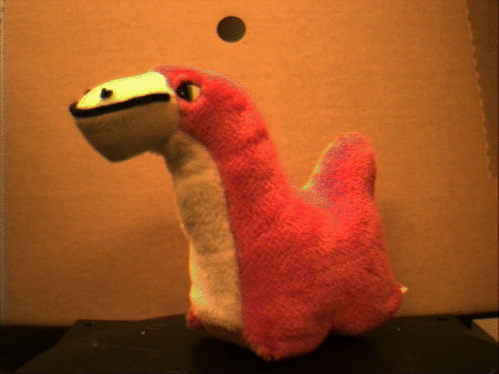
What is Computer Vision?
3D Model
Images by Real Cameras
Dog?
Camel?
Edible?
Interpretation

Slide 7

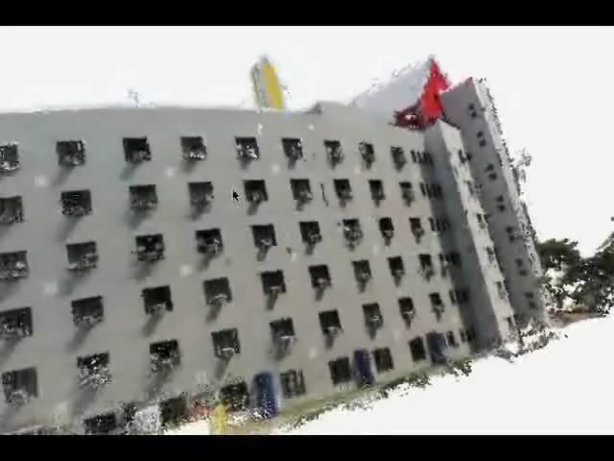

Slide 8
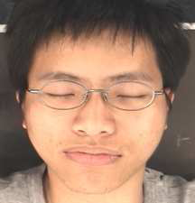
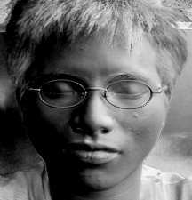
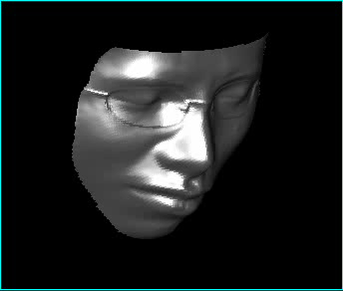
~400 photos
Normal map
Surface

Slide 9
Recommended Text
Computer Graphics Principles and Practice by Foley, van Dam, Feiner, Hughes. Second Edition in C. Addison Wesley, 1996.
Reference Books:
Computer Graphics (second edition) C-version by Donald Hearn & M. Pauline Baker, Prentice Hall
3D Computer Graphics by Alan Watt. Third Edition. Addison-Wesley. 2000.
Inteactive Computer Graphics: A top-down approach with OpenGL by Edward Angel. Second Edition. Addison Wesley. 2000.
The OpenGL Programming Guide (aka Red and Blue Book) by OpenGL Architecture Review Board. Addison Wesley. Link to electronic version is available on course homepage.

Slide 10

Grading Policy
Four computer projects 60%
Homework 1%
Final/End-Term Exam 39%

Slide 11
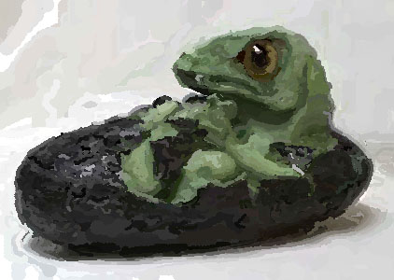
Project 1: Impressionist
image processing
alpha blending
color
basic OpenGL
basic FLTK (UI) programming

Slide 12
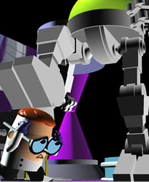
Project 2: Modeler
Rigid body transform (2D, 3D)
Hierarchical modeling
Build your model for the animator project

Slide 13
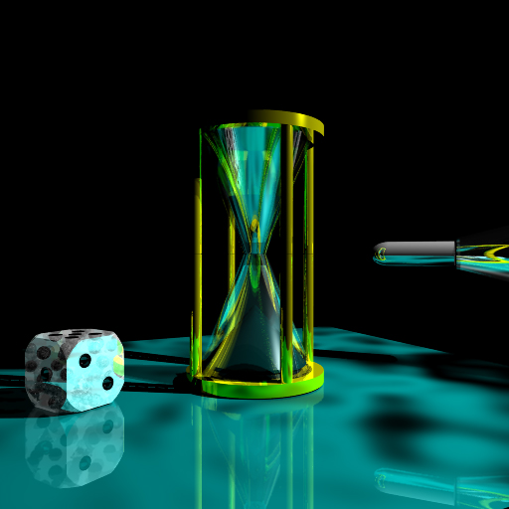
Project 3: Trace
Hidden surface removal
Ray tracing
Shading model
Interpolative shading

Slide 14
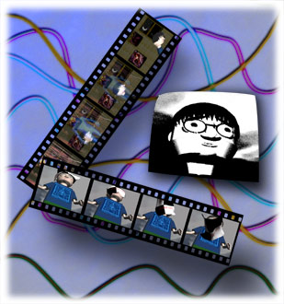
Project 4: Animate
Animate your hierarchical model
Parametric curves
Particle systems

Slide 15
What it takes to Pass 4411?
Score well in Impressionist and Modeler
Projects 1 and 2 are easier
Your projects satisfy the basic requirements
They account for ~30% of your grade
Skip the difficult Trace and Animator
Homework
Help you prepare the final (1%)
Solution will be given
Final
Reasonable (20-45%)

Slide 16
What it takes to get A- or above?
Score well in all projects
Your projects satisfy the basic requirements
Homework
Do well in final (usually 25% similar to acceptance rate of CVPR)

Slide 17



What it takes to get A+?
Top of the class
or
You are in the range of A- or A, and that your projects satisfy the basic requirements plus extras

Slide 18
Remarks
1. CS 4411 requires knowledge in C or C++ and OpenGL programming. It will take a lot of your time, but it is a very useful course.
Basic OpenGL will be covered in the project help session. But the best way to learn is by studying examples and working on the projects.
2. All projects are to be completed in a group up to 2 students. Your group is given a total of 8 late days credit that can be used in any project. However, no bonus will be counted if your project is late, regardless your late days credit.
3. Absolutely no sharing or copying of code among groups!! Offender will be given a failure grade and the case will be reported to his/her major department.

